Slide 1
…Welcome…

Slide 2
Introduction to DBMS and Data Warehousing
By – Shivraj Wankar
(MSBI Specialist – SQL Server, SSIS, SSRS,PowerBI)

Slide 3
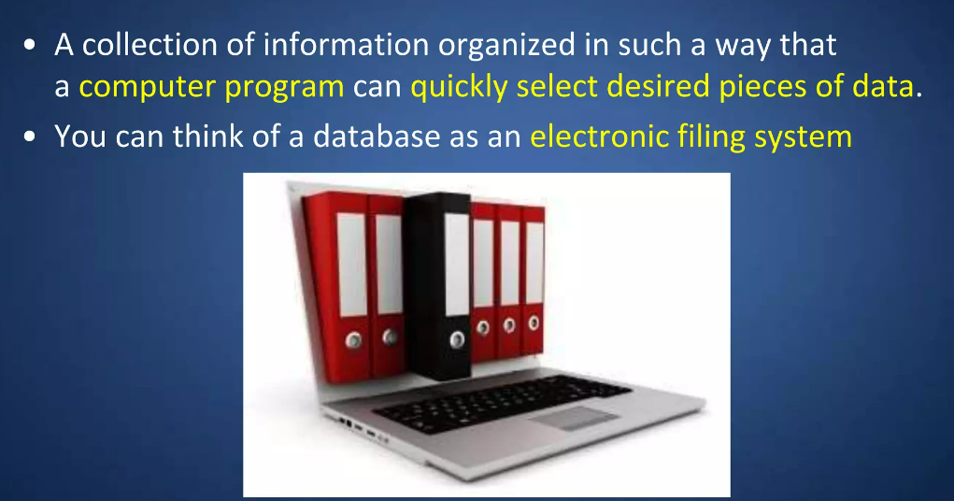
What is Database?

Slide 4
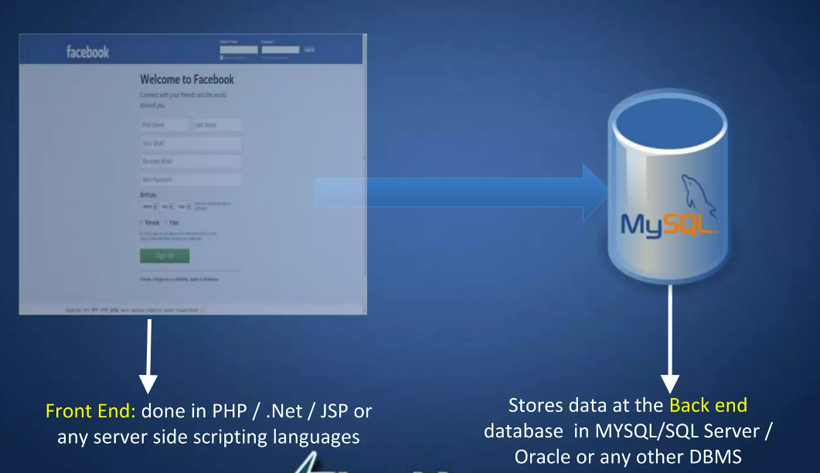
Where do we use Database?

Slide 5
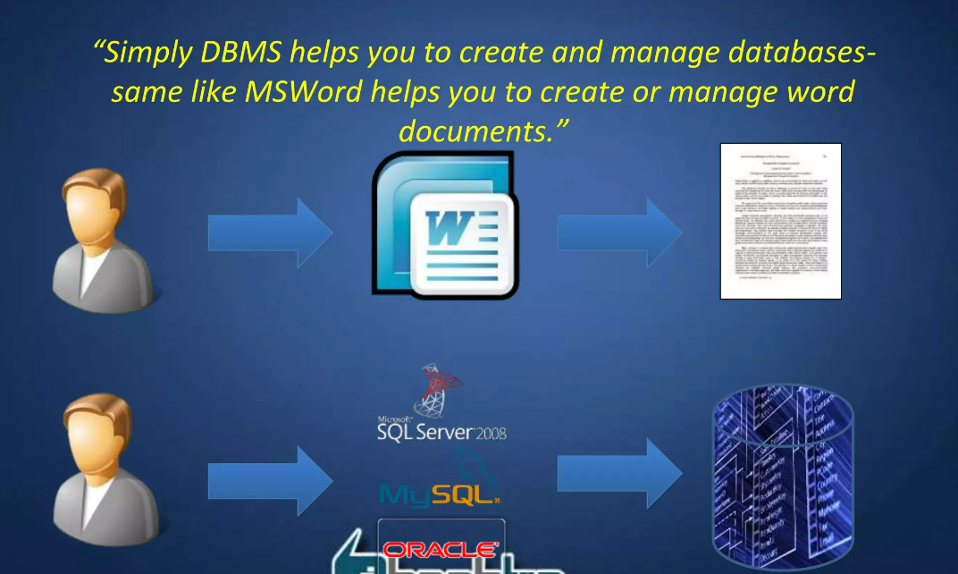
Database Management Systes (DBMS)

Slide 6
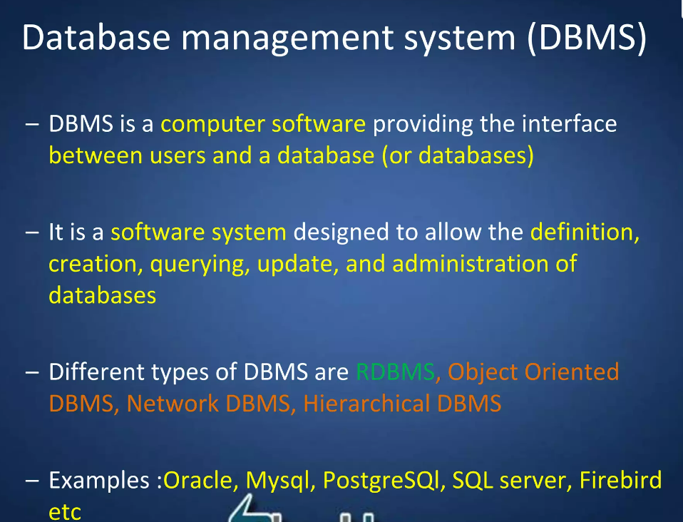

Slide 7
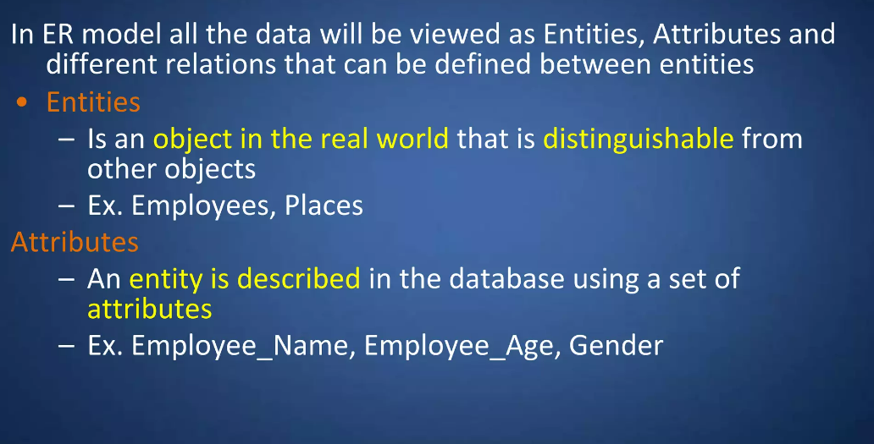
The RDBMS – Relational Database Management System follows Entity-Relationship model.
What is ER(Entity-Relationship) data model?

Slide 8
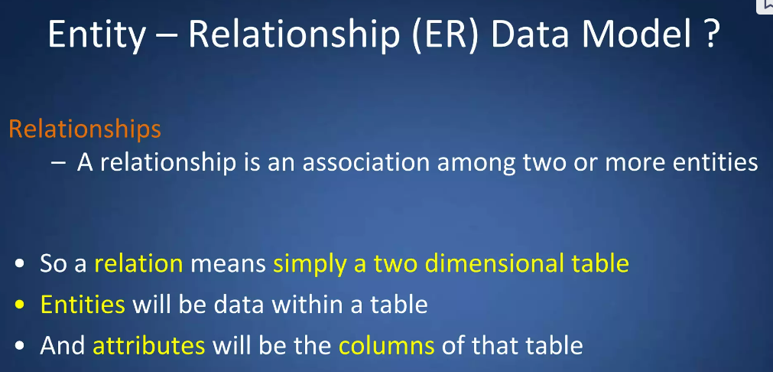
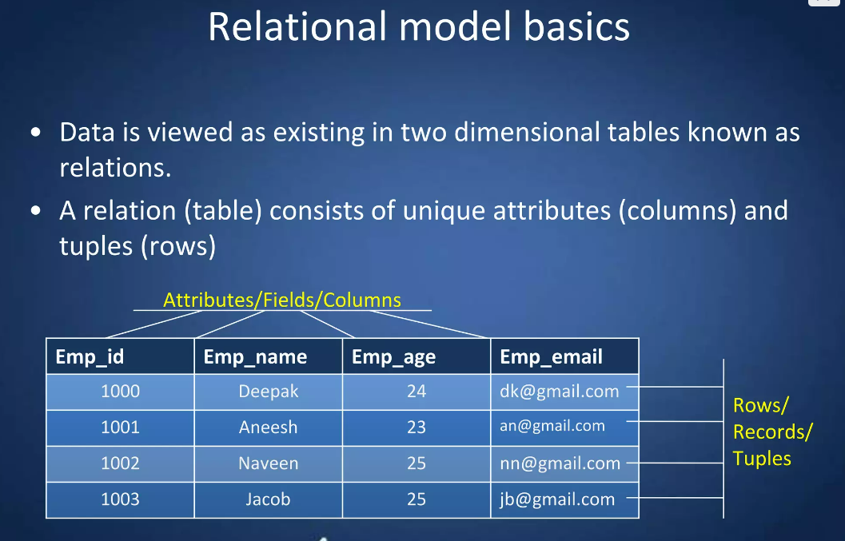

Slide 9
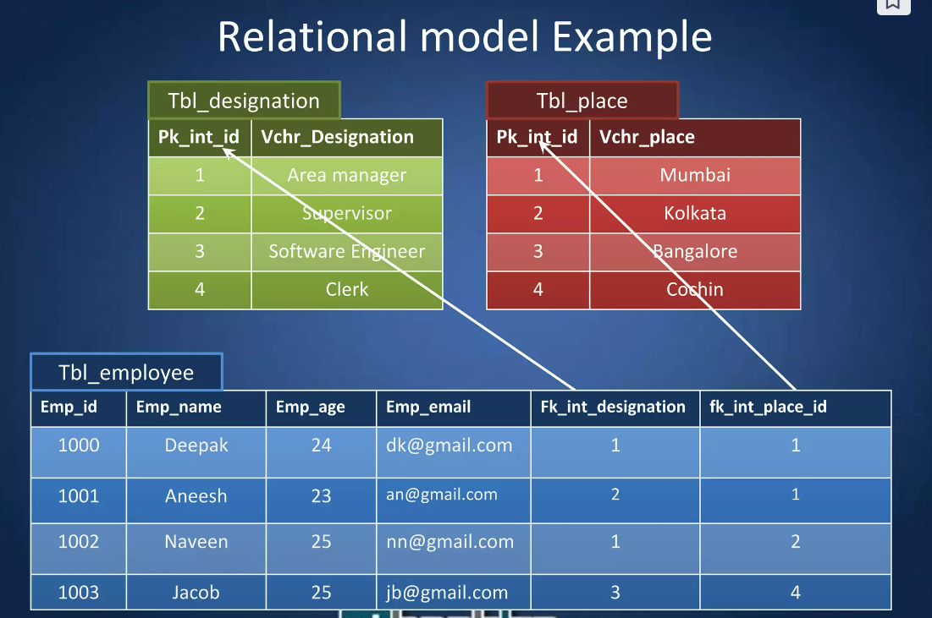

Slide 10
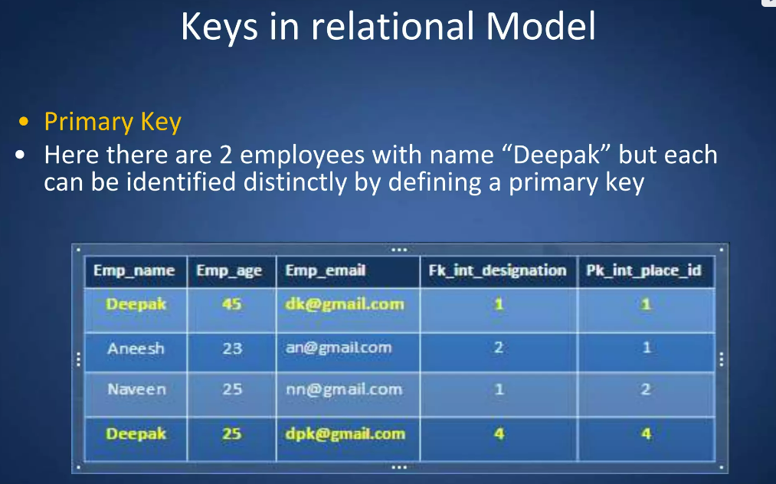
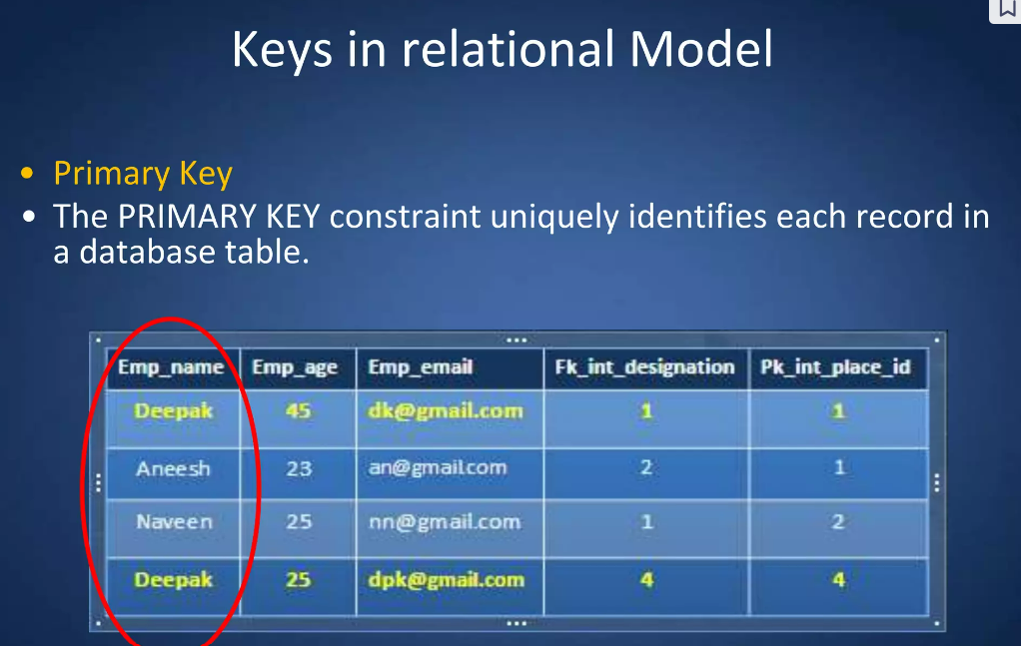

Slide 11
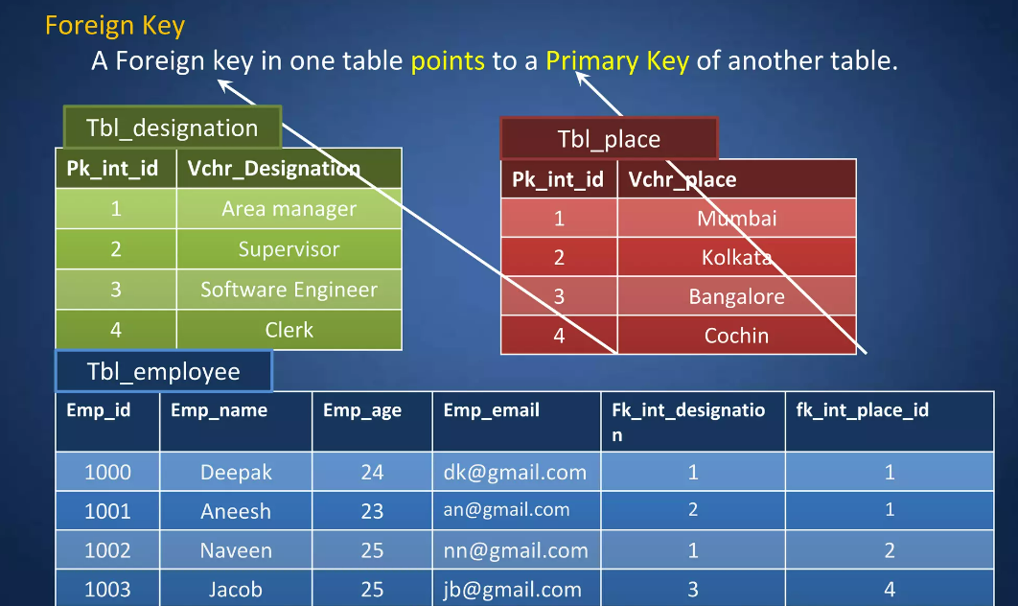

Slide 12
Microsoft SQL Server (MS-SQL), MySQL, Oracle, IBM these are some of the some of the relational databases.
Large amount of data is generated by multiple software's on daily basis using above RDBMS. There is need to represent this data to higher management, generate reports, analysis for the finance team. Hence the concept of data warehousing is came into the picture.
Data warehousing uses combination of technologies to process the data. Those are RDBMS (MS-SQL), ETL tool (SSIS), Analysis Tool (SSAS), Reporting tools (SSRS).

Slide 13
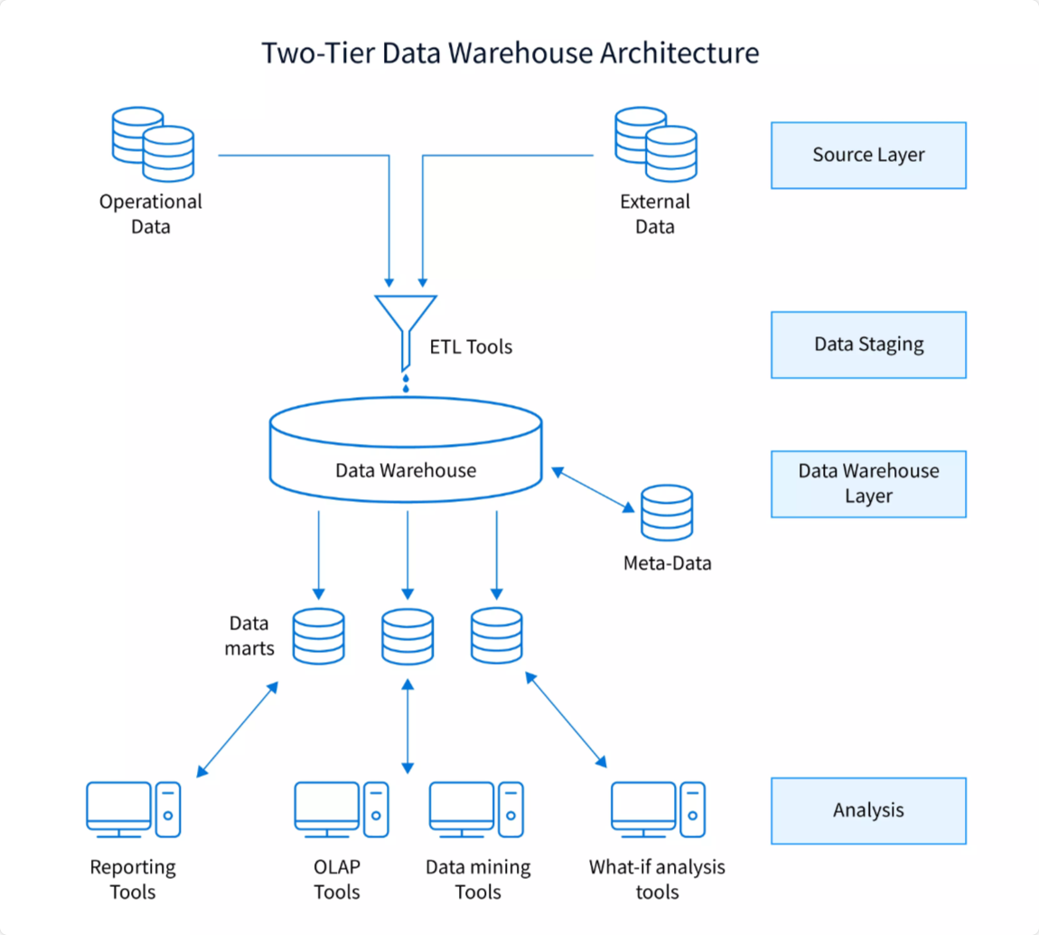
What is a Data Warehouse?
A Data Warehouse (DW) is a relational database that is designed for query and analysis rather than transaction processing. It includes historical data derived from transaction data from single and multiple sources.
A Data Warehouse provides integrated, enterprise-wide, historical data and focuses on providing support for decision-makers for data modelling and analysis.
A Data Warehouse is a group of data specific to the entire organization, not only to a particular group of users.
It is not used for daily operations and transaction processing but used for making decisions.

Slide 14
Questions??

Slide 15
SQL SERVER/MS SQL – DATABASE – QUERY RUN AGAINST THIS
SSMS – DBMS --
SQL – Language -- QUERY

